Slide 1
Fraud Detection using Data Sampling methods
By: Muhammad Aizad bin Mohd Ridzo (16053936)
BCNS

Slide 2
Problem STATEMENT
The imbalanced nature of the financial dataset might lead to inaccurate model readings.
The limited number of financial datasets for research purposes due to customer’s privacy.
Aims and goals:
To improve the accuracy of the classification of the minority class.
To increase the model’s metric score : precision, recall, f-measure and area under the precision recall curve (PRC).
Notes:
the problem with the study of fraud detection is the state of the dataset.
the dataset is highly imbalanced where they are more genuine transactions compared to fraudulent transactions.
this imbalanced in data can result in the inaccurate reading of the model.
the second is the lack of dataset that are available for research.
financial datasets are kept private by banks and companies.
this is to protect the customers private information
therefore, there are limited options of datasets for research purposes in the study of fraud detection.
the aim of this study is to improve the accuracy of the classification of the minority class in a highly imbalanced dataset.
the goal is to improve the performance metric scores of precision, recall, f-measure and area under the precision recall curve (PRC).

Slide 3
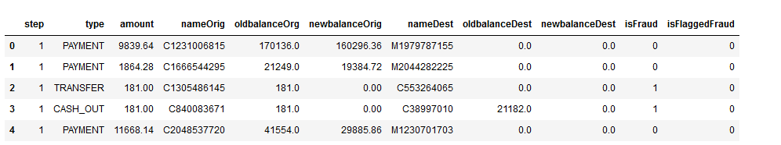
Dataset description
Synthetic financial transaction dataset generated through simulation.
The dataset contains over 6 million rows of transaction data and 11 features.
There are no empty nor negative values within the dataset
Five types of transactions (CASH_IN, CASH_OUT, DEBIT, PAYMENT, and TRANSFER)
Notes:
The dataset that I have used in this experiment is called the Synthetic Financial Dataset for Fraud Detection from Kaggle.
This dataset is generated through simulation using aggregated data from private datasets in order to replicate existing financial dataset in the real world.
It contains over 6 million rows of transaction data and 11 features.
There are no empty nor negative values within the dataset and they are 5 types of transactions which are cash in, cash out, debit, payment and transfer.

Slide 4
Experiment workflow
EDA
Data pre-processing
Resampling Data
Modelling
Evaluation
Notes:
EDA is to gather insights regarding the dataset.
Data preprocessing is a technique where it transform raw data into an understandable format for modelling.
Before modelling we resample the data to balance the class distribution using both over-sampling and under-sampling technique.
In the modelling process we will be using three classifiers which are Logistic Regression, Random Forest and Extreme Gradient Boost.
Finally, we evaluate the model results by using the performance metrics which are precision, recall, f-measure and area under the precision recall curve.

Slide 5
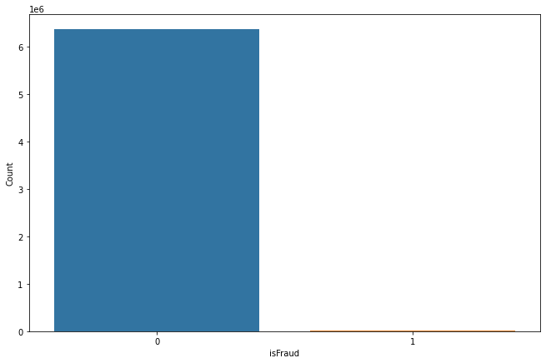
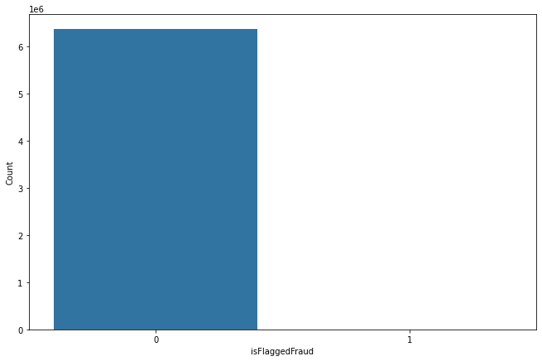
Exploratory Data ANALYSIS (EDA)
Number of fraudulent transactions
Number of flagged transactions
Number of isFraud (1): 8213
Number of isFraud(0): 6,354,407
Number of isFlaggedFraud (1): 16
Number of isFlaggedFraud (0): 6,362,604

Slide 6

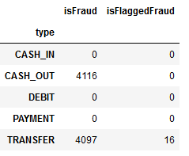
Exploratory Data analysis (EDA)
Fraudulent transactions originates from both ‘CASH_OUT’ and ‘TRANSFER’.
There has been miscalculations in columns: "newbalanceOrig“, and "newbalanceDest“.

Slide 7
Data PRE-PROCESSING
Feature Selection
Standard Encoder
One Hot Encoder
Dropping ‘step’, ‘isFlaggedFraud’,’nameDest’, and ‘nameOrig’.
Creating new columns: ‘errorBalanceOrg’, ‘errorBalanceDest’ to solve calculation error.
Apply on numerical columns: 'amount', 'oldbalanceOrg', 'newbalanceOrig', 'oldbalanceDest', 'newbalanceDest’, 'errorBalanceOrg’ and 'errorBalanceDest’.
Used to standardize the mean and standard deviation of the features.
Binary encodes features.
Apply on categorical column: ‘type’.
Notes:
df["errorBalanceOrg"] = df.newbalanceOrig + df.amount - df.oldbalanceOrg
df["errorBalanceDest"] = df.oldbalanceDest + df.amount - df.newbalanceDest

Slide 8
MODELLING CLASSIFIERS
Logistic Regression
Random Forest
Extreme Gradient Boosting (XGBoost)
Pros: Easy to implement and trained. Commonly used as a baseline.
Cons: Performance of the algorithm is weak when used with complex dataset.
Pros: Runs efficiently on a large dataset.
Cons: Prone to overfitting.
Pros: Well known for its ability to produce good results.
Cons: Need to apply pre-processing techniques such as label encoding for it to produce better results.
Notes:
The three modelling classifiers that I will be using in this experiment are Logistic Regression, Random Forest and Extreme Gradient Boosting.
First, LR is very famous amongst researches because it is very easy to implement and trained. Normally, LR is used as a baseline. However, the performance of the algorithm is weak when compared to other sophisticated algorithm especially when tested on large and complex dataset.
Second, Random Forest excels in classification algorithms. It runs efficiently on large datasets. However, it is very prone to overfitting.
Lastly, XGBoost is the newest addition to the boosting algorithm family. It has received tons of positive feedbacks due to its ability to produce good results. However, to get the best results, data preprocessing must be carried out before.

Slide 9
Data SAMPLING TECHNIQUES
Random Under Sampling
Synthetic Minority Over-sampling Technique (SMOTE)
Under samples majority data by removing data samples randomly.
Over samples minority data by adding synthetic data samples using KNN methods.

Slide 10
Results
RANDOM UNDER SAMPLING (RUS)
Synthetic Minority Over-sampling Technique (SMOTE)
Sampling | Number of fraud data | Number of genuine data
Normal | 8213 | 6354407
RUS | 8213 | 8213
Sampling | Number of fraud data | Number of genuine data
Normal | 8213 | 6354407
SMOTE | 6354407 | 6354407
Models | Precision | Recall | F1 Score | PRC
LR | 0.02 | 0.93 | 0.04 | 0.55
RF | 0.85 | 1.0 | 0.92 | 1.0
XGB | 0.58 | 1.0 | 0.73 | 0.99
Models | Precision | Recall | F1 Score | PRC
LR | 0.02 | 0.93 | 0.04 | 0.55
RF | 0.89 | 1.0 | 0.94 | 0.99
XGB | 0.86 | 1.0 | 0.92 | 1.0
Notes:
Before I get into the results, I will first explain the performance metrics that I have chosen for this experiment.
As mentioned previously I will evaluate the model’s outcome with the suggested metrics as opposed to using the accuracy score.
This is because of the severe imbalance in the dataset. The minority class has a higher cost which will influence the model’s accuracy.
In result the model will return misleading accuracy scores which does not represent the actual accuracy of the classification. Therefore, it is highly unreliable.
To solve the problem I have used precision, recall, f-measure (f1 score) and area under the precision recall curve (prc) which can be derived from the confusion matrix table.
Performance metrics:
Precision= False Positive Rate (rate of predicted fraud but actually genuine)
Recall = False Negative Rate (rate of genuine but actually fraud)
F-measure = a measure of a model's accuracy by using precision and recall.
PRC = a useful measurement that shows a tradeoff between the precision and recall to evaluate predictions of binary classifications.
From the results, models with SMOTE performs better than models that was sample with RUS.
The reason because when RUS is carried out it removes data samples including information which can contribute to the performance of the classifiers.
We can see that in XGB precision and F1 scores has increased significantly as well as RF compared to the one in RUS.
However, LR still maintains its results even after using SMOTE.
Therefore we can conclude that SMOTE performs better than RUS and it can be seen in XGB in terms of precision and PRC score.
Terms
over fitting : it occurs when an algorithm is fed with a lot of unnecessary data.

Slide 11
Future considerations
Exploring other data sampling methods such as Random Oversampling method and Adaptive Synthetic (ADASYN).
Deploy other types of classification algorithm such as artificial neural network (ANN) and Support Vector Machine (SVM).
Notes:
In this slide I have considered few considerations to improve the experiment in the future.
The first is to explore other sampling methods such as Random Oversampling and Adaptive Synthetic (ADASYN) technique.
The second one is to increase the number of classifiers use in the experiment such as artificial neural network and support vector machine.

Slide 12
Thank you

